Slide 1
Linux Kernel Module
Author: PhuLA
This training materials are reused from multiple sources including FSOFT materials and NXP training document, public document
Internal Used Only

Slide 2
Agenda
Introduce
Main component
Data structure
Linking with external function
Module dependency
Load a kernel module
Communicate with a kernel module
Assignment

Slide 3
INTRODUCE
Kernel module:
Code that executes as part of the Linux kernel.
Extends the capabilities and some times might modify the behavior of the kernel.
Can edit behavior of the kernel at runtime with out recompile it.
Notes:
- What is the Kernel Module feature?
- Kernel Module feature accept load some object file, which contains code to extend the running kernel. When they are no longer require, they can be unload to free memory.
- What things a kernel module can do?
- A kernel can work as driver, get some data in kernel, unit test for kernel code we wrote, implement a new feature for Linux and so on.
- What things a kernel module can not do?
- Modprobe process is the manager of all kernel module, so we can not load a kernel module before this process is loaded. So for every event occur before Modprobe loaded, we can not use kernel module to change them. Example: CPU initialize, memory initialize and so on.

Slide 4
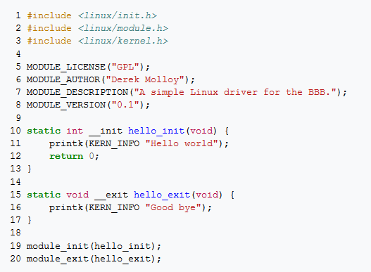
MAIN COMPONENT
Example with a simplest kernel module:
Notes:
- We will travel and explain each line in above sample code. #include ...: A kernel module can use #include to include an other source code. But it can only include a kernel header or independent header. Include a header in "linux" directory is safely. If you include a user-space header like stdio.h, your kernel module will crash in run time. Because a kernel module run in kernel-space but stdio include source code come from user-space, so a kernel module can not access to stdio source code. We will discuss more for this problem in a latter lesson, when you can understand the different between kernel-space and user-space.
- MODULE_LICENSE, MODULE_AUTHOR, MODULE_DESCRIPTION, MODULE_VERSION: The kernel module information to display for user when they use "modinfo" command.
NOTE: For MODULE_LICENSE macro, each module developer should specify in the source code the type of license, if the license is not GPL-compatible, the module will not be able to use many core functions and data structure, which use - - EXPORT_SYMBOL_GPL macro. So we suggest you should use GPL or GPLv2 for this macro.
- static int __init hello_init(void): this is prototype for init function of a kernel module. You can think init function like a main function, it is the first function will be execute when we load a kernel module with "insmod" command. Init function return 0 in case of success, but in some case, if it meet any problem, it can return a native value to notify with modprobe process.
- static void __exit hello_exit(void): This is a function will be called when system unload a kernel module. Linux kernel doesn't care about status of __exit function, that why the exit function has void type.
module_init, module_exit: Both macro to notify for kernel what is init and exit function of a kernel module.

Slide 5
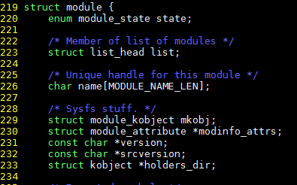
DATA STRUCTURE
Linux kernel define struct module (linux/include/module.h) to store all information of a kernel module.
Notes:
After loading a kernel module to system, kernel will create a module object from struct module. After that, it put the new object to a double linker list. When ever it detect a new device plug in to system, it will lookup a correct driver from this list. To get module detail for struct module, you can read it source code in linux/include/module.h, in this lesson, we don't cover it in detail.

Slide 6
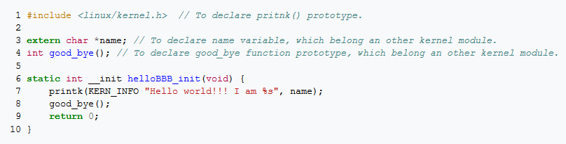

LINKING WITH EXTERNEL FUNCTION
A kernel module can call a function come from kernel source code or from an other kernel module. But it has some different with the calling external function for an application.
Explain more detail with an example:
My kernel module call good_bye() function and “name” variable from an other kernel module.
In my kernel module:
In target kernel module:
Notes:
Now, I think you will wonder: How EXPORT_SYMBOL macro can public a function or variable to out side kernel module. The answer is very simple, it put function and variable address in parentheses into _ _ksymtab section, so a out side kernel module can look up in it and access the needed address.

Slide 7
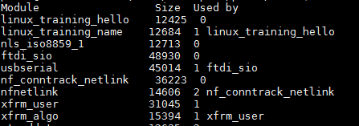
MODULE DEPENDENCY
Module dependency:
If module A call function X in module A then module A is depend on B. To load A, we have to load B first.
Use lsmod command to see modules relationship.
Module usage counter.
Module depend on.
Notes:
- Module usage counter: It is number of dependency kernel module still running in system. When ever a kernel module which use any function of my kernel module is loaded into kernel, the user_count filed in module object of our kernel module will be increase. We can not unload a kernel module have this field is greater than zero. Linux kernel checks this field before it unload a kernel module, if this field is greater than zero, kernel doesn't unload it and return a error value. Kernel have to do that because, unload a kernel module while a other depend module is running is danger, when a depend kernel module call a function in unloaded module, the system can be crash.
- Module depend on: In binary file of any kernel module store a list name of function and variable from out side. So, before kernel load a module, it read this list name first and look up all name in _ _ksymtab section, if it can find all name, the module will be load, if not, kernel returns a error value and it doesn't load this module. So in case of our kernel module, the module define good_bye() function have to load before our kernel module.

Slide 8
LOAD A KERNEL MODULE
System has 3 cases to load a kernel module:
In booting time, system has some code or script, they call command "insmod" to load a kernel module.
In running time, user can run "insmod" command with a path to load a specify kernel module.
When a new device plug in into system.
Notes:
When a new device plug in into system. Kernel will get some hardware information like major number, minor number, then it raise a hot plug event to user-space. /sbin/hotplug program handles this event. It will get the string "bustype:vendor:product:version" which store device information. Hotplug program will read in file /lib/modules/3.13.0-24-generic/modules.alias to find a kernel module matches up with this device. Then it load a correct kernel module to drive new device.

Slide 9
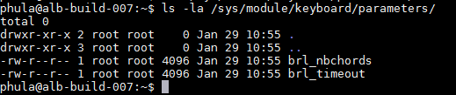
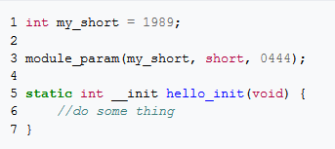
COMMUNICATE WITH A KERNEL MODULE
We have to way to communicate with a kernel module:
IPC - Inter Process Communication
Module parameter.
Notes:
Module parameter: I it same with process parameter. When you run a process like this command "/bin/ls /dev/", you run ls application with "/dev/" parameter. So we can do that with a kernel module with a little different. To create a kernel module parameter, your code will like this:
User can read or write your module parameter in "/sys/module/your_module_name/parameters/your_param_name". We will explain the above code. module_param is a macro do define a module parameter, my_short is parameter name, short is parameter type, 0444 is permission of parameter.

Slide 10
ASSIGNMENT
You can chose an assignment in this list to practice or find practice in the internet.
Create a kernel module to write a value to specify register.
Create a kernel module to print value of any export variable in driver or kernel source code.
Create a kernel module to print log every time you plugin a keyboard to PC.
Create a kernel module to swap a system call.

Slide 11
REFERENCE
Understanding the Linux Kernel, 3rd Edition - Appendix B. Modules.
Understanding Linux Network Internals - Chapter 5 Network Device Initialization.
The Linux Kernel Module Programming Guide.

Slide 12
Q & A

Slide 13
Thank You!

